Slide 1


Unit #5
Trees and Graphs

Slide 2
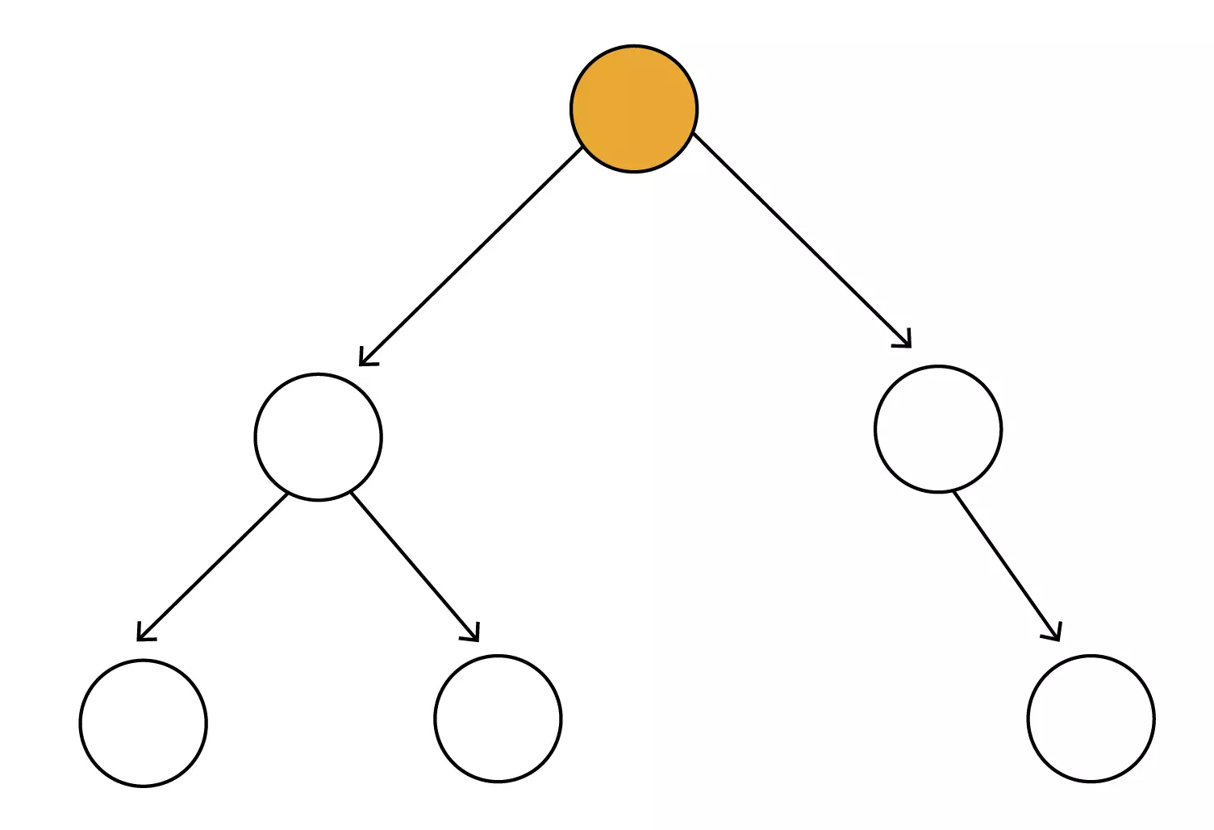
Trees in Data Structure
A tree data structure is a hierarchical structure that is used to represent and organize data in a way that is easy to navigate and search. It is a collection of nodes that are connected by edges and has a hierarchical relationship between the nodes.
The topmost node of the tree is called the root, and the nodes below it are called the child nodes. Each node can have multiple child nodes, and these child nodes can also have their own child nodes, forming a recursive structure.
Root Node (Starting Node)

Slide 3
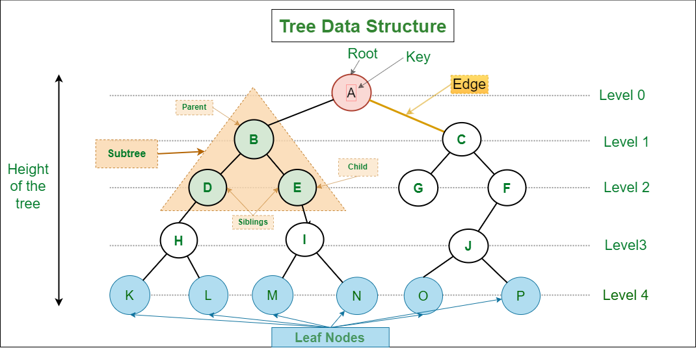

Slide 4
Basic Terminologies In Tree Data Structure:
Parent Node: The node which is a predecessor of a node is called the parent node of that node. {B} is the parent node of {D, E}.
Child Node: The node which is the immediate successor of a node is called the child node of that node. Examples: {D, E} are the child nodes of {B}.
Root Node: The topmost node of a tree or the node which does not have any parent node is called the root node. {A} is the root node of the tree. A non-empty tree must contain exactly one root node and exactly one path from the root to all other nodes of the tree.
Leaf Node or External Node: The nodes which do not have any child nodes are called leaf nodes. {K, L, M, N, O, P} are the leaf nodes of the tree.
Ancestor of a Node: Any predecessor nodes on the path of the root to that node are called Ancestors of that node. {A,B} are the ancestor nodes of the node {E}.
Descendant: Any successor node on the path from the leaf node to that node. {E,I} are the descendants of the node {B}.

Slide 5
Sibling: Children of the same parent node are called siblings. {D,E} are called siblings.
Level of a node: The count of edges on the path from the root node to that node. The root node has level 0.
Internal node: A node with at least one child is called Internal Node.
Neighbor of a Node: Parent or child nodes of that node are called neighbors of that node.
Subtree: Any node of the tree along with its descendant.

Slide 6
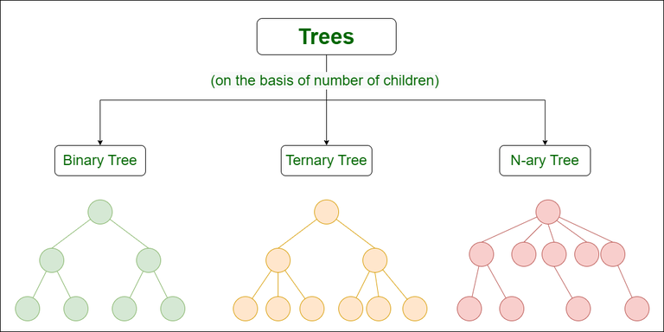
Types of Tree data structures:
Binary tree: In a binary tree, each node can have a maximum of two children linked to it. Some common types of binary trees include full binary trees, complete binary trees, balanced binary trees, and degenerate or pathological binary trees.
Ternary Tree: A Ternary Tree is a tree data structure in which each node has at most three child nodes, usually distinguished as “left”, “mid” and “right”.
N-ary Tree or Generic Tree: Generic trees are a collection of nodes where each node is a data structure that consists of records and a list of references to its children(duplicate references are not allowed). Unlike the linked list, each node stores the address of multiple nodes.

Slide 7
Basic Operation Of Tree Data Structure:
Create – create a tree in the data structure.
Insert − Inserts data in a tree.
Search − Searches specific data in a tree to check whether it is present or not.
Traversal:
Preorder Traversal – perform Traveling a tree in a pre-order manner in the data structure.
In order Traversal – perform Traveling a tree in an in-order manner.
Post-order Traversal –perform Traveling a tree in a post-order manner.

Slide 8
Preorder traversal
Preorder traversal is defined as a type of tree traversal that follows the Root-Left-Right policy where:
The root node of the subtree is visited first.
Then the left subtree is traversed.
At last, the right subtree is traversed.

Slide 9
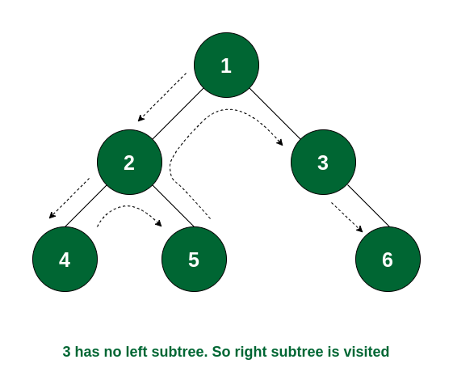
Preorder traversal Order
So the order of traversal of nodes is 1 -> 2 -> 4 -> 5 -> 3 -> 6.

Slide 10
Inorder traversal
Inorder traversal is defined as a type of tree traversal technique which follows the Left-Root-Right pattern, such that:
The left subtree is traversed first
Then the root node for that subtree is traversed
Finally, the right subtree is traversed

Slide 11
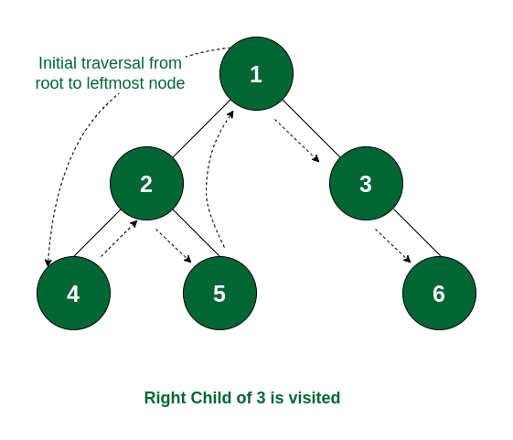
Inorder traversal Order
So the order of traversal of nodes is 4 -> 2 -> 5 -> 1 -> 3 -> 6.

Slide 12
Postorder traversal
Postorder traversal is defined as a type of tree traversal which follows the Left-Right-Root policy such that for each node:
The left subtree is traversed first
Then the right subtree is traversed
Finally, the root node of the subtree is traversed

Slide 13

Postorder traversal Order
So the order of traversal of nodes is 4 -> 5 -> 2 -> 6 -> 3 -> 1.

Slide 14
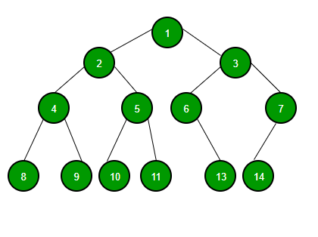
Binary Tree
Binary Tree is defined as a tree data structure where each node has at most 2 children. Since each element in a binary tree can have only 2 children, we typically name them the left and right child.

Slide 15
Binary Tree Representation
A Binary tree is represented by a pointer to the topmost node (commonly known as the “root”) of the tree. If the tree is empty, then the value of the root is NULL. Each node of a Binary Tree contains the following parts:
Data
Pointer to left child
Pointer to right child
Basic Operation On Binary Tree:
Inserting an element.
Removing an element.
Searching for an element.
Traversing the tree.

Slide 16
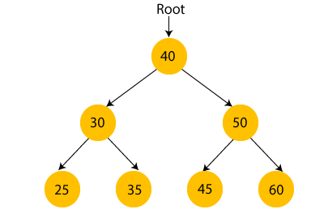
Binary Search tree (BST)
A binary search tree follows some order to arrange the elements. In a Binary search tree, the value of left node must be smaller than the parent node, and the value of right node must be greater than the parent node. This rule is applied recursively to the left and right subtrees of the root.
In the above figure, we can observe that the root node is 40, and all the nodes of the left subtree are smaller than the root node, and all the nodes of the right subtree are greater than the root node.

Slide 17
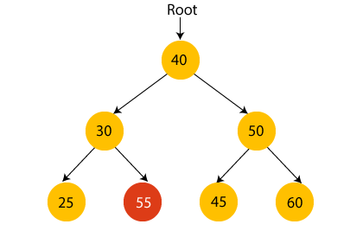
Suppose if we change the value of node 35 to 55 in the above tree, check whether the tree will be binary search tree or not.
In the above tree, the value of root node is 40, which is greater than its left child 30 but smaller than right child of 30, i.e., 55. So, the above tree does not satisfy the property of Binary search tree. Therefore, the above tree is not a binary search tree.

Slide 18
#include <iostream>
class Node {
public:
int data;
Node* left;
Node* right;
Node(int value) : data(value), left(nullptr), right(nullptr) {}
};
class BinarySearchTree {
private:
Node* root;
// Private recursive helper functions
Node* insert(Node* node, int value);
Node* search(Node* node, int value);
Node* remove(Node* node, int value);
Node* findMin(Node* node);
void inOrderTraversal(Node* node);
public:
BinarySearchTree() : root(nullptr) {}
// Public methods
void insert(int value);
bool search(int value);
void remove(int value);
void inOrderTraversal();
};
// Insert a value into the BST
Node* BinarySearchTree::insert(Node* node, int value) {
if (node == nullptr) {
return new Node(value);
}
if (value < node->data) {
node->left = insert(node->left, value);
} else if (value > node->data) {
node->right = insert(node->right, value);
}
return node;
}
void BinarySearchTree::insert(int value) {
root = insert(root, value);
}
// Search for a value in the BST
Node* BinarySearchTree::search(Node* node, int value) {
if (node == nullptr || node->data == value) {
return node;
}
if (value < node->data) {
return search(node->left, value);
} else {
return search(node->right, value);
}
}
bool BinarySearchTree::search(int value) {
return search(root, value) != nullptr;
}

Slide 19
// Remove a value from the BST
Node* BinarySearchTree::remove(Node* node, int value) {
if (node == nullptr) {
return node;
}
if (value < node->data) {
node->left = remove(node->left, value);
} else if (value > node->data) {
node->right = remove(node->right, value);
} else {
// Node with only one child or no child
if (node->left == nullptr) {
Node* temp = node->right;
delete node;
return temp;
} else if (node->right == nullptr) {
Node* temp = node->left;
delete node;
return temp;
}
// Node with two children:
//Get the inorder successor (smallest in the right subtree)
Node* temp = findMin(node->right);
// Copy the inorder successor's content to this node
node->data = temp->data;
// Delete the inorder successor
node->right = remove(node->right, temp->data);
}
return node;
}
void BinarySearchTree::remove(int value) {
root = remove(root, value);
}
// Find the node with the minimum value in the BST
Node* BinarySearchTree::findMin(Node* node) {
while (node->left != nullptr) {
node = node->left;
}
return node;
}
// In-order traversal of the BST
void BinarySearchTree::inOrderTraversal(Node* node) {
if (node != nullptr) {
inOrderTraversal(node->left);
std::cout << node->data << " ";
inOrderTraversal(node->right);
}
}
void BinarySearchTree::inOrderTraversal() {
inOrderTraversal(root);
std::cout << std::endl;
}
int main() {
BinarySearchTree bst;
bst.insert(50);
bst.insert(30);
bst.insert(70);
bst.insert(20);
bst.insert(40);
bst.insert(60);
bst.insert(80);
std::cout << "In-order traversal: ";
bst.inOrderTraversal();
int searchValue = 60;
if (bst.search(searchValue)) {
std::cout << searchValue << " found in the tree." << std::endl;
} else {
std::cout << searchValue << " not found in the tree." << std::endl;
}
int deleteValue = 30;
bst.remove(deleteValue);
std::cout << "In-order traversal after deleting " << deleteValue << ": ";
bst.inOrderTraversal();
return 0;
}

Slide 20
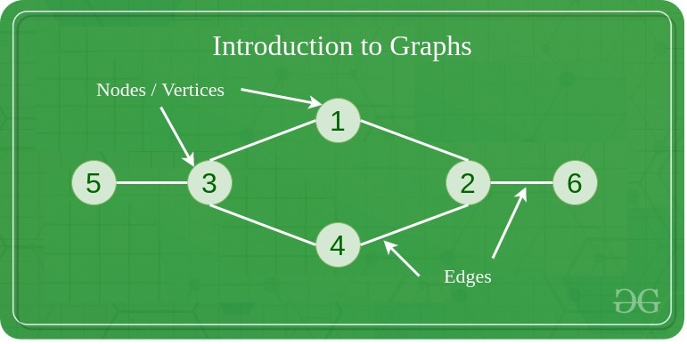
Introduction to Graph
A Graph is a non-linear data structure consisting of vertices and edges. The vertices are sometimes also referred to as nodes and the edges are lines or arcs that connect any two nodes in the graph. More formally a Graph is composed of a set of vertices( V ) and a set of edges( E ). The graph is denoted by G(V, E).
Let's try to understand this through an example. On facebook, everything is a node. That includes User, Photo, Album, Event, Group, Page, Comment, Story, Video, Link, Note...anything that has data is a node.

Slide 21
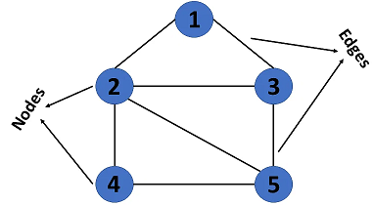
Components of a Graph
Vertices: Vertices are the fundamental units of the graph. Sometimes, vertices are also known as vertex or nodes. Every node/vertex can be labeled or unlabeled.
Edges: Edges are drawn or used to connect two nodes of the graph. It can be ordered pair of nodes in a directed graph. Edges can connect any two nodes in any possible way. There are no rules. Sometimes, edges are also known as arcs. Every edge can be labelled/unlabeled.

Slide 22
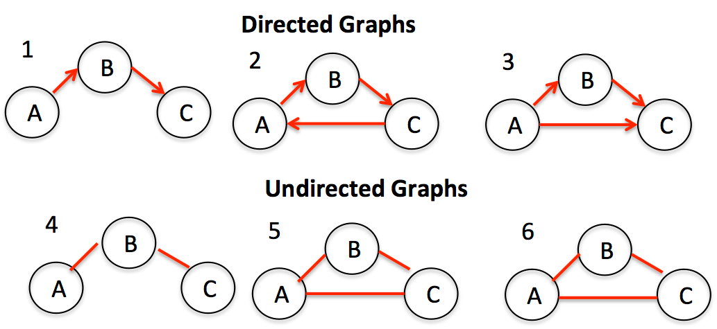
Types Of Graph
Undirected Graph: A graph in which edges do not have any direction. That is the nodes are unordered pairs in the definition of every edge. The edges do not have a direction.
Directed Graph: A graph in which edge has direction. That is the nodes are ordered pairs in the definition of every edge.

Slide 23
Graph traversal algorithms
Traversal means visiting all the nodes of a graph. The graph has two types of traversal algorithms. These are called the
Breadth First Search and
Depth First Search.
Breadth First Search (BFS)
The Breadth First Search (BFS) traversal is an algorithm, which is used to visit all of the nodes of a given graph. In this traversal algorithm one node is selected and then all of the adjacent nodes are visited one by one. After completing all of the adjacent vertices, it moves further to check another vertices and checks its adjacent vertices again.

Slide 24
BFS algorithm
A standard BFS implementation puts each vertex of the graph into one of two categories:
Visited
Not Visited
The purpose of the algorithm is to mark each vertex as visited.
The algorithm works as follows:
Start by putting any one of the graph's vertices at the back of a queue.
Take the FRONT item of the queue and add it to the visited list.
Create a list of that vertex's adjacent nodes. Add the ones which aren't in the visited list to the back of the queue.
Keep repeating steps 2 and 3 until the queue is empty.

Slide 25
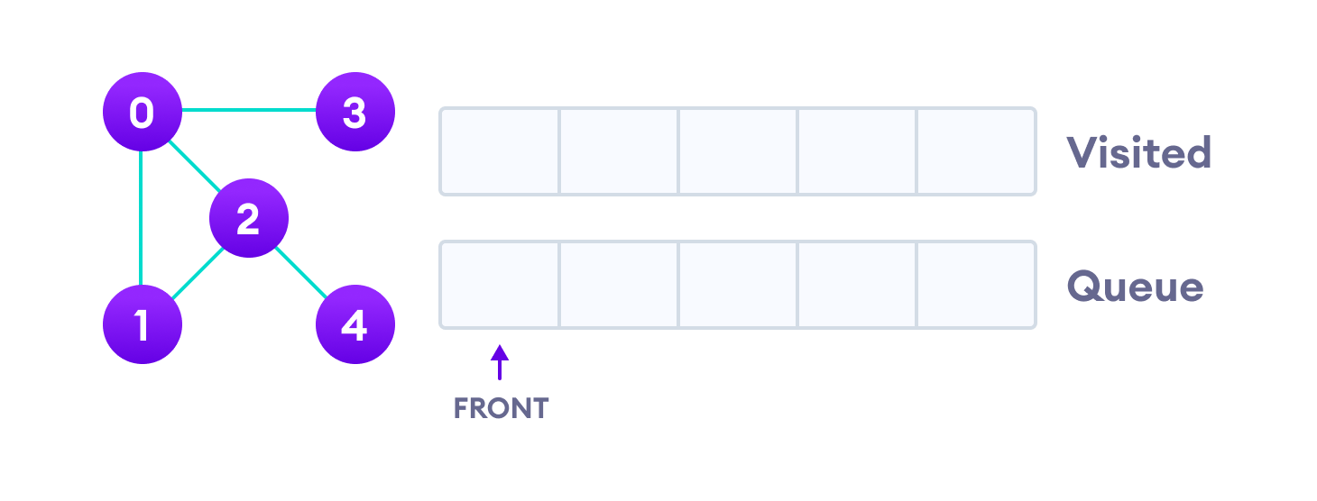
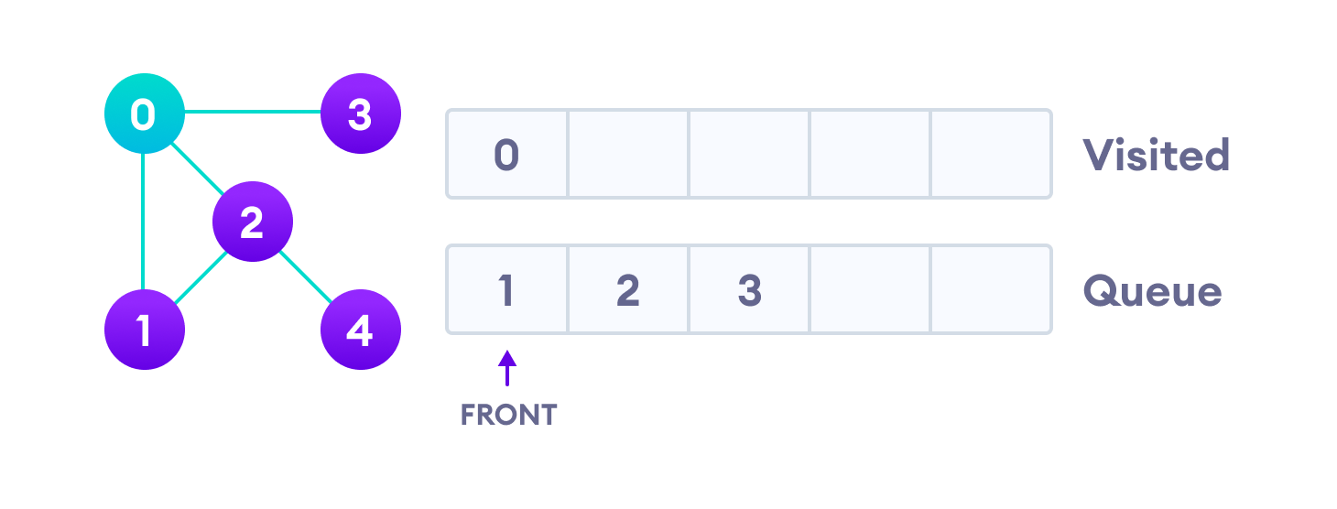
BFS example
Let's see how the Breadth First Search algorithm works with an example. We use an undirected graph with 5 vertices.
We start from vertex 0, the BFS algorithm starts by putting it in the Visited list and putting all its adjacent vertices in the stack
Next, we visit the element at the front of queue i.e. 1 and go to its adjacent nodes. Since 0 has already been visited, we visit 2 instead.

Slide 26
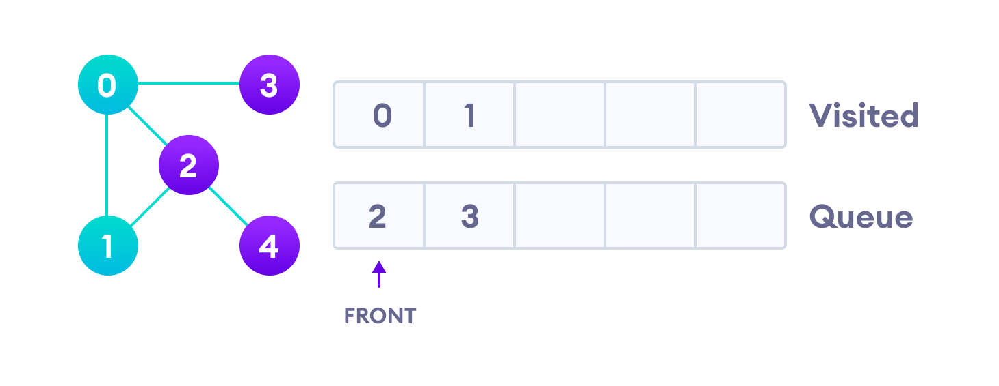
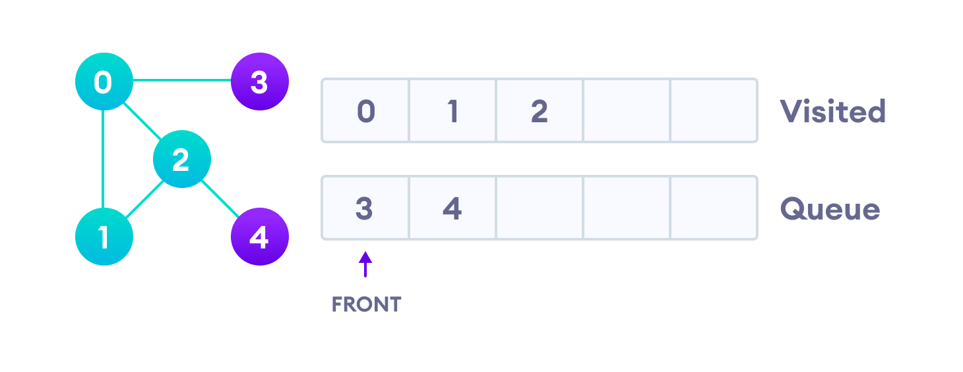
Vertex 2 has an unvisited adjacent vertex in 4, so we add that to the back of the queue and visit 3, which is at the front of the queue.

Slide 27
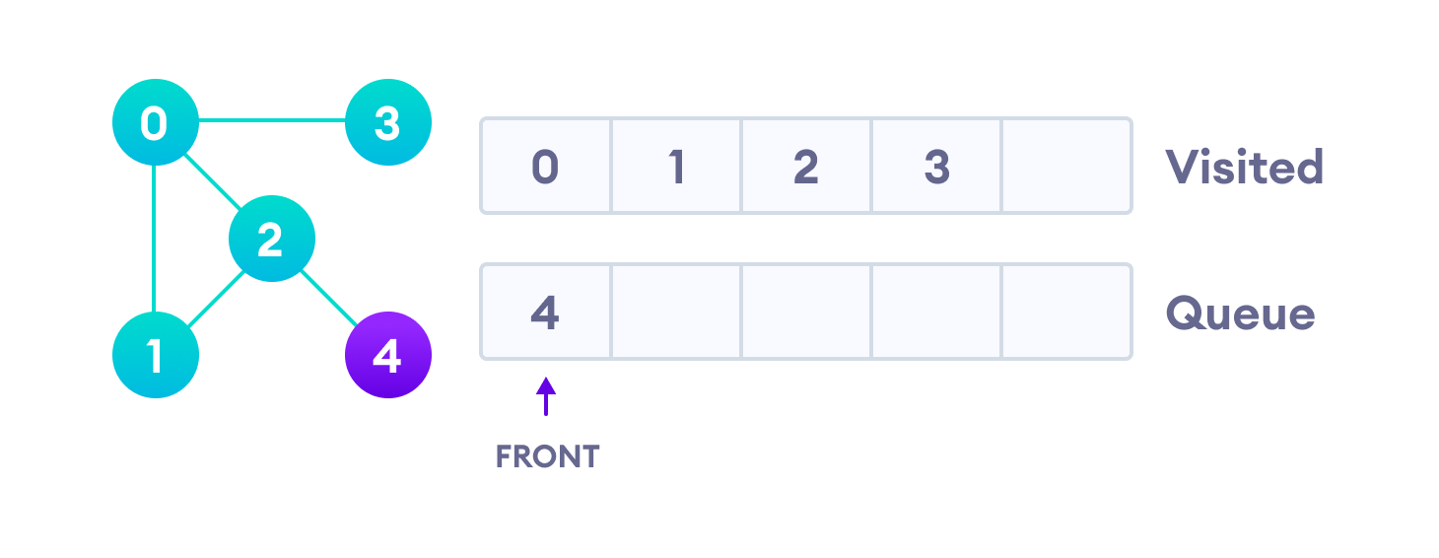
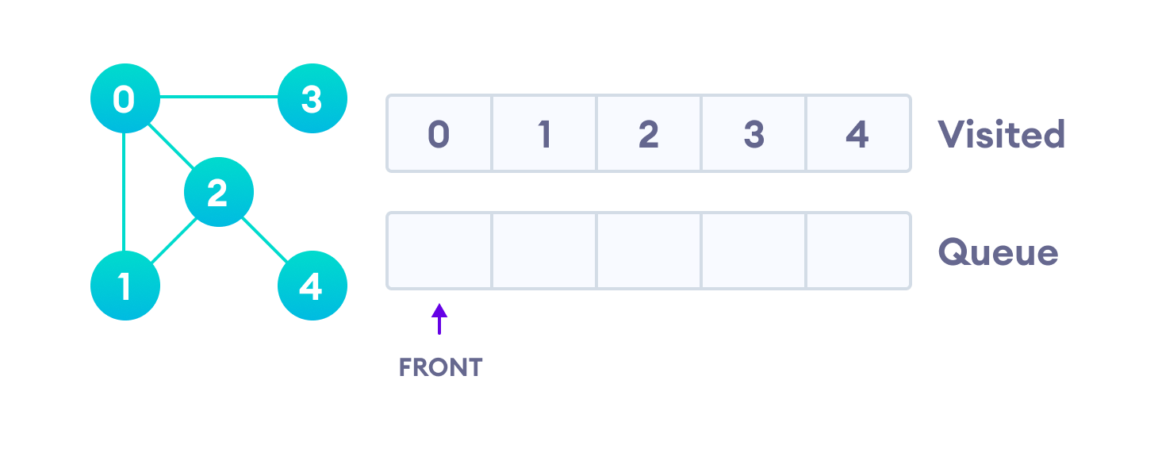
Only 4 remains in the queue since the only adjacent node of 3 i.e. 0 is already visited. We visit it.
Since the queue is empty, we have completed the Breadth First Traversal of the graph.

Slide 28
Depth First Search (DFS) algorithm
A standard DFS implementation puts each vertex of the graph into one of two categories:
Visited
Not Visited
The purpose of the algorithm is to mark each vertex as visited.
The algorithm works as follows:
Start by putting any one of the graph's vertices at the back of a Stack.
Take the TOP item of the queue and add it to the visited list.
Create a list of that vertex's adjacent nodes. Add the ones which aren't in the visited list to the top of the stack.
Keep repeating steps 2 and 3 until the stack is empty.

Slide 29
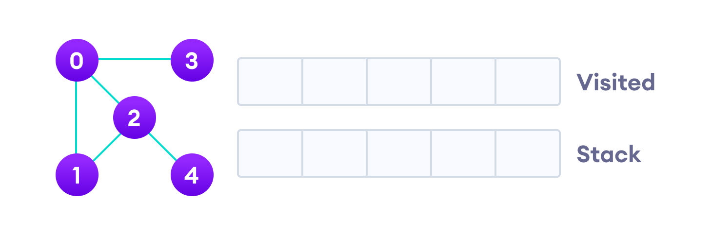
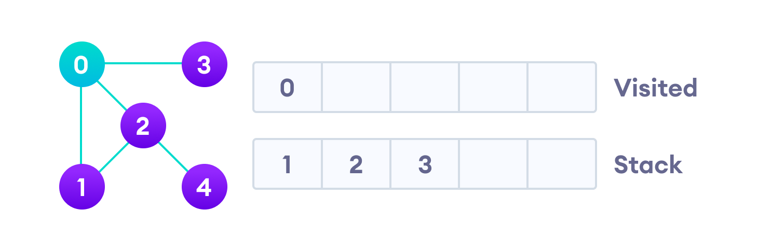
Depth First Search Example
Let's see how the Depth First Search algorithm works with an example. We use an undirected graph with 5 vertices.
We start from vertex 0, the DFS algorithm starts by putting it in the Visited list and putting all its adjacent vertices in the stack.
Next, we visit the element at the top of stack i.e. 1 and go to its adjacent nodes. Since 0 has already been visited, we visit 2 instead.

Slide 30
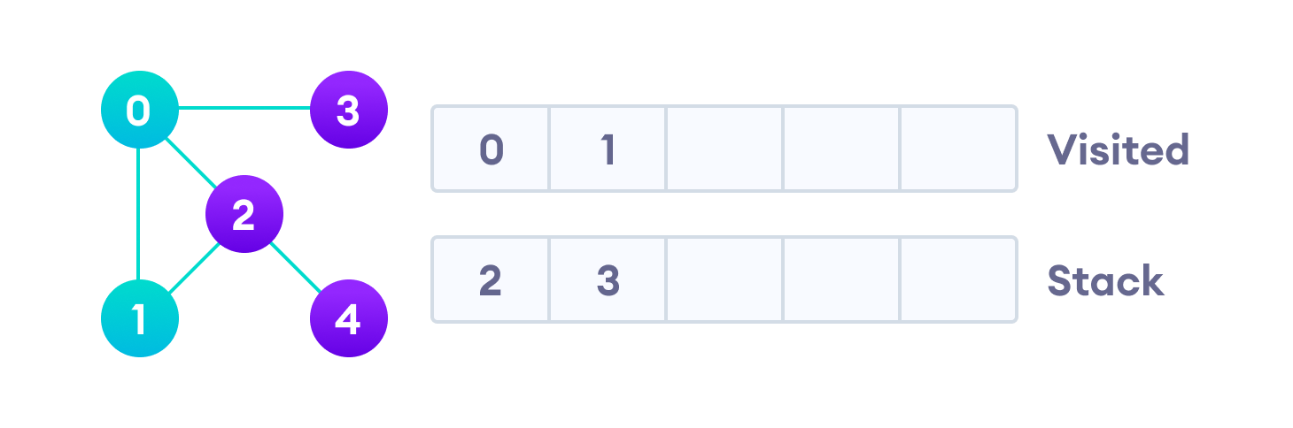
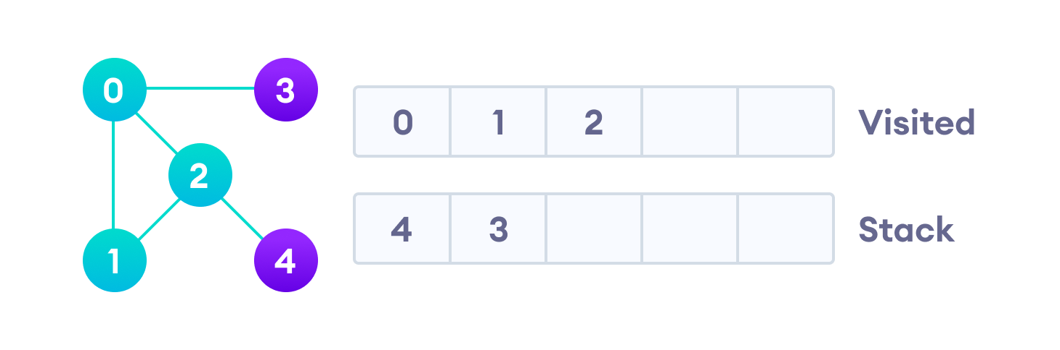
Vertex 2 has an unvisited adjacent vertex in 4, so we add that to the top of the stack and visit it.

Slide 31
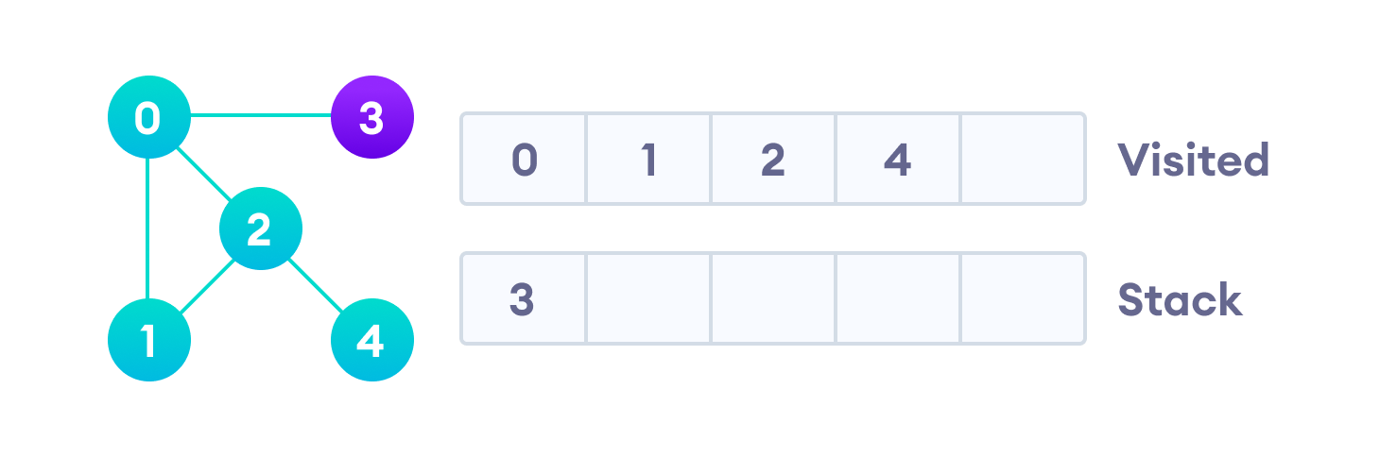
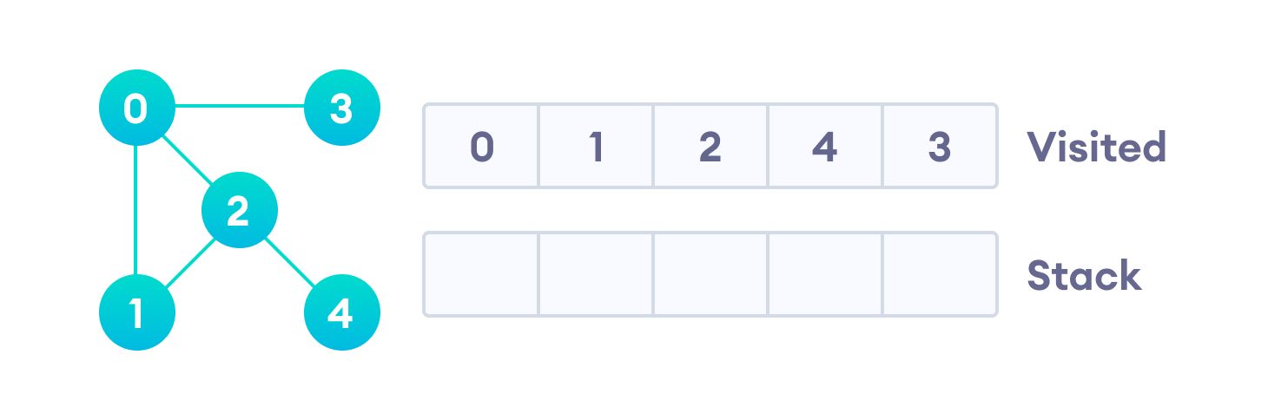
After we visit the last element 3, it doesn't have any unvisited adjacent nodes, so we have completed the Depth First Traversal of the graph.
After we visit the last element 3, it doesn't have any unvisited adjacent nodes, so we have completed the Depth First Traversal of the graph.

Slide 33
Thank You

